Slide 1

Web Scraping in R
By: Donya Mohamed

Slide 2

What is Web Scraping?
The art of extracting information from the HTML, CSS, and Javascript lines of code from a web page
Automated process and therefore reduces the error of collecting data by hand and saves time
Allows us to collect and organize data from multiple public sources to identify patterns and trends that are not immediately visible
Involves accessing data from websites without explicit permission of the owner which raises ethical concerns
Be sure to read the terms and conditions before scraping large amounts of data

Slide 3
Web Scraping vs. APIs
API- Application Programming Interface; a set of protocols that allow different applications to communicate with each other
- When a website provides an API, it means they have allowed developers to access their data in a structured way
- Many APIs limit the amount of data you can access within a certain time period
- Not all websites provide APIs
If APIs are limiting, web scraping is an alternative

Slide 4

How Does it Work?
HTTP GET request
Parsing HTML content
CSS selector
XPath
Getting HTML element attributes
Notes:
HTTP GET request is simply identifying the page you want to scrape
Parsing the HTML content using CSS selector or Xpath. We use Chrome DevTools to access elements of a webpage that you want to scrape. For times sake today we will focus on CSS selector only
Getting HTML attributes means you render all of the elements into a readable summary

Slide 5
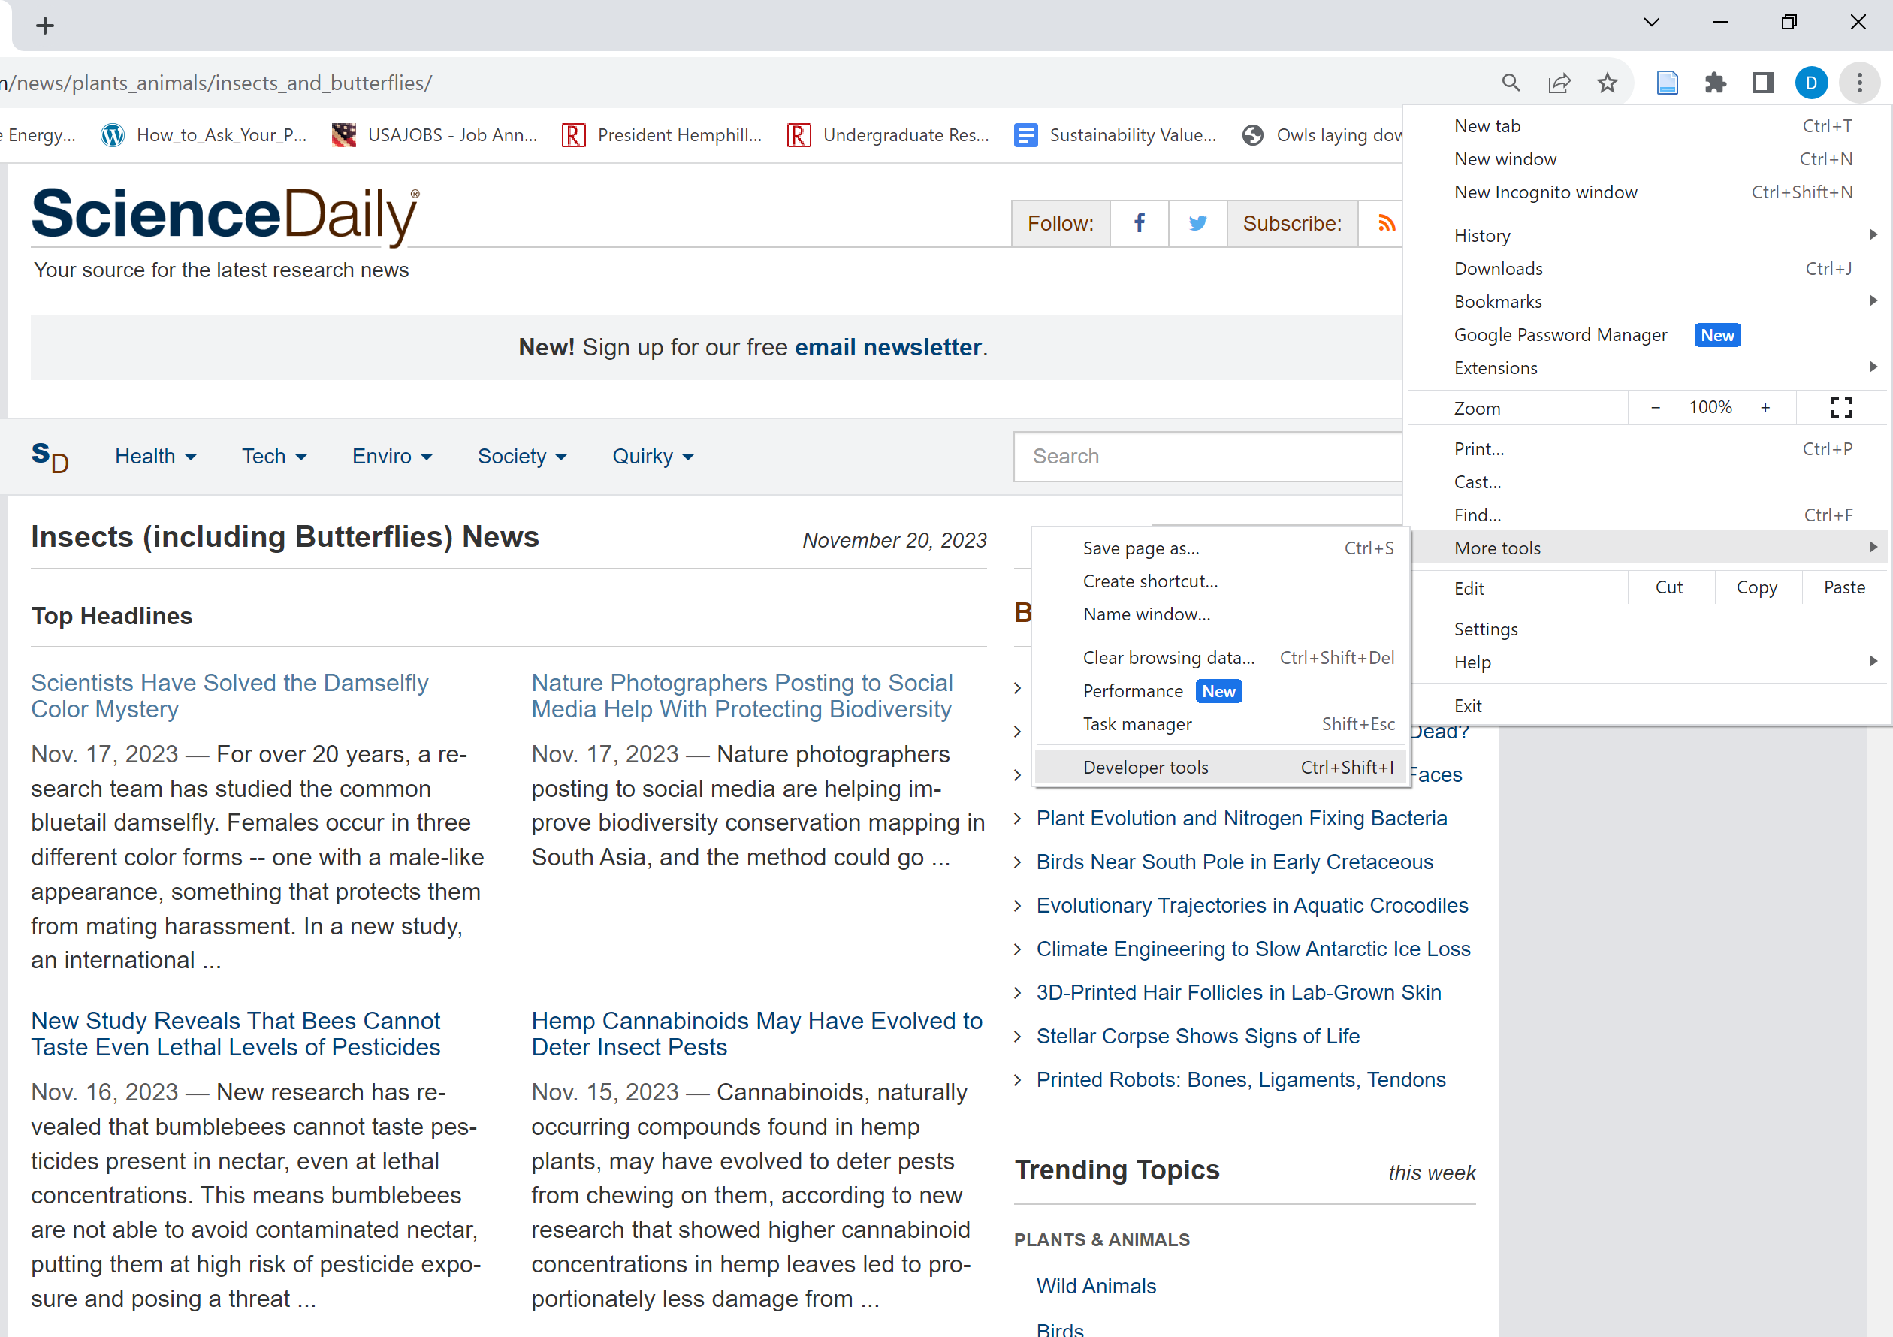
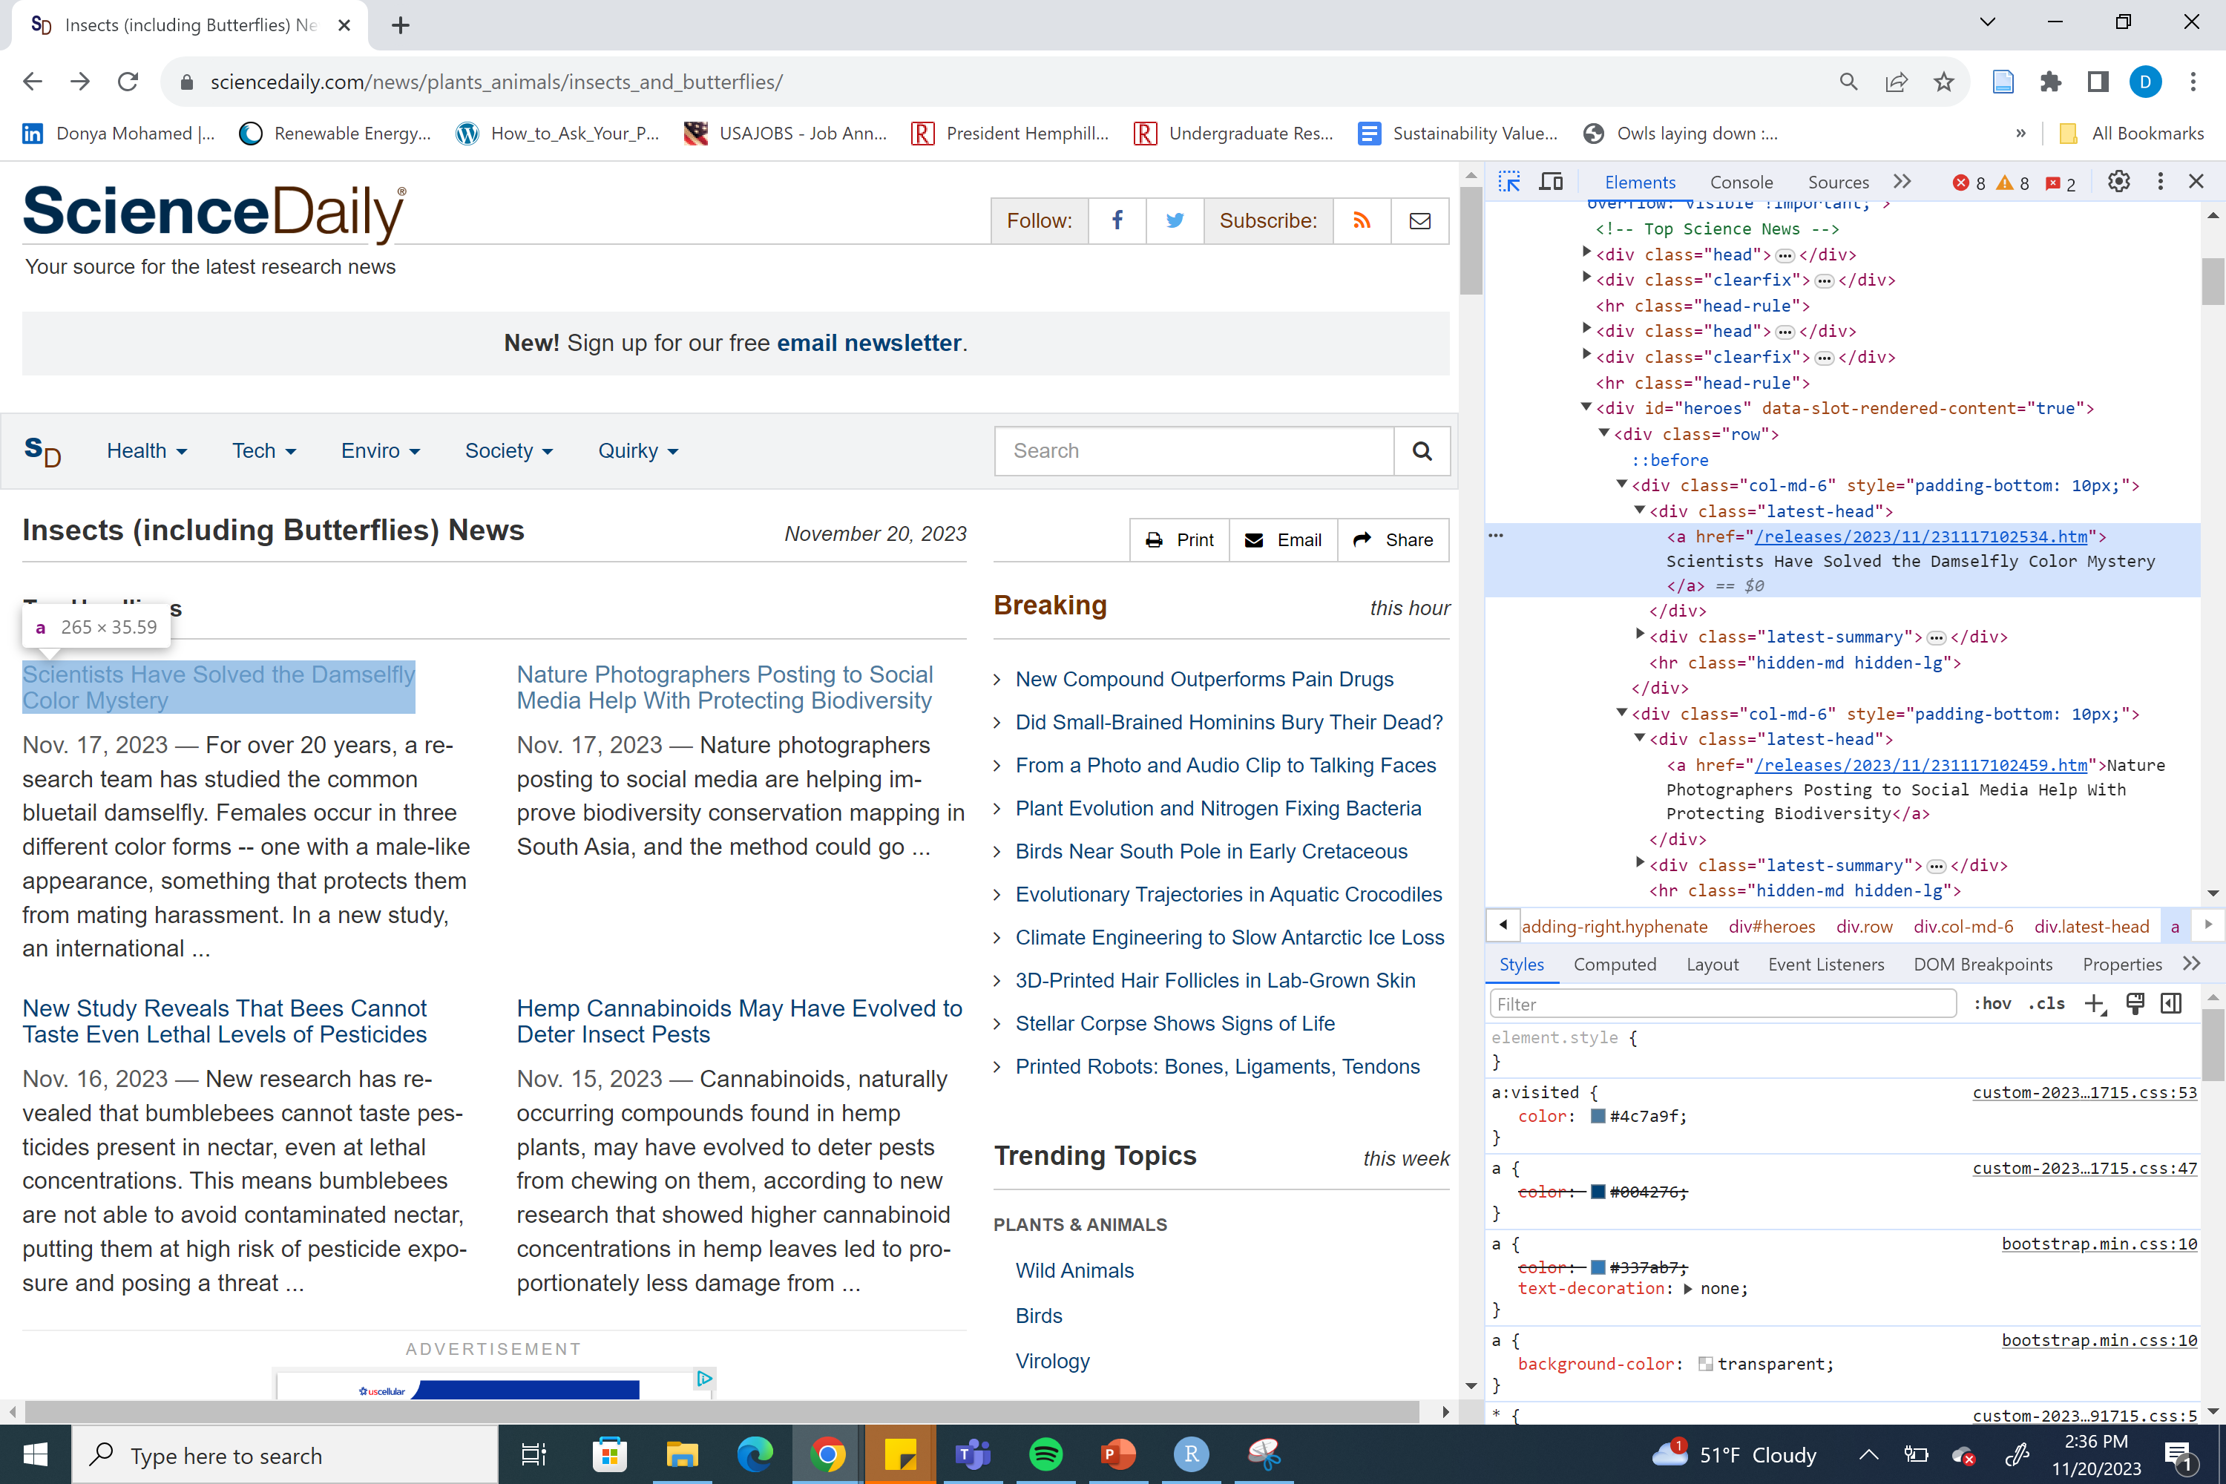
Summarizing Insects in the News Headlines

Slide 6
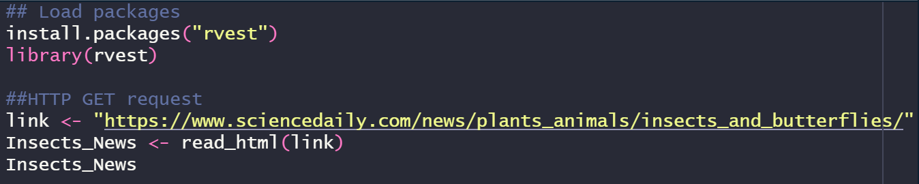
Packages and HTTP GET Request

Slide 7
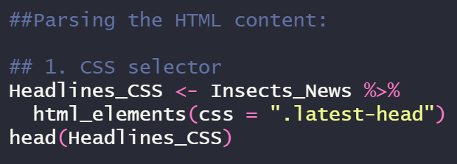
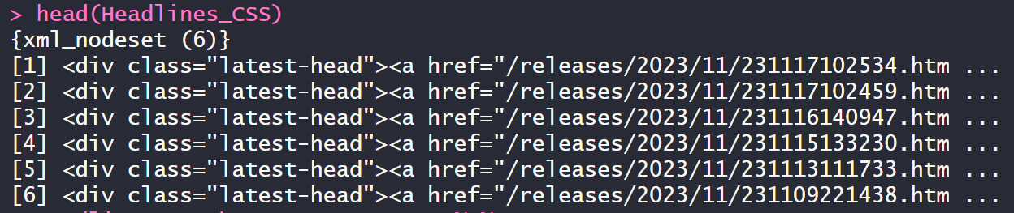
Parsing the HTML content: CSS selector
Notes:
I click on the top left icon that allows me to hover over elements to identify them. Since I want to scrape the headlines, so I hover over a headline and identify the corresponding element. In this case, we see the element is “latest-head” so we identify the html element in r as such. This summary is a bunch of links that make no sense to me.

Slide 8
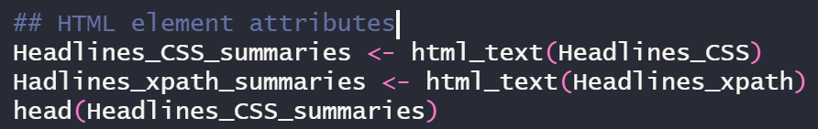
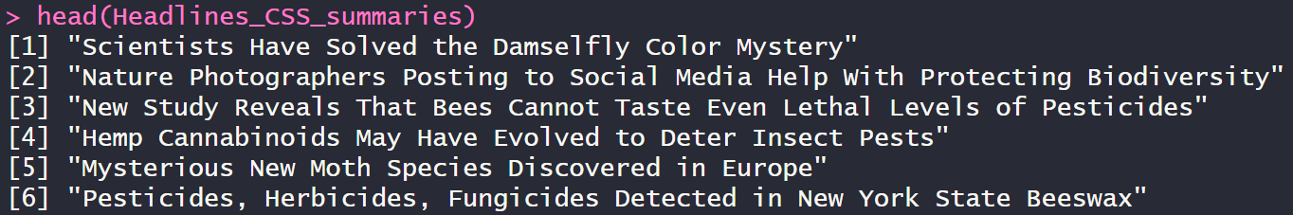
HTML element attributes

Slide 9

Questions?

Slide 10
References
https://statsandr.com/blog/web-scraping-in-r/#a-real-application-of-web-scraping-in-r
https://brightdata.com/blog/how-tos/web-scraping-with-r
https://www.linkedin.com/advice/3/how-can-web-scraping-used-improve-education-data-innovation#:~:text=However%2C%20education%20data%20is%20often,%2C%20social%20media%2C%20and%20databases.

